Slide 1
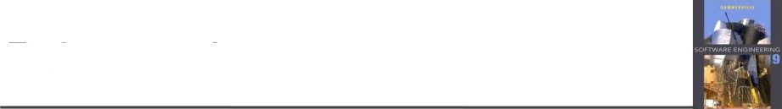
Requirements Engineering
Functional and non-functional requirements
Requirements specification
The software requirements specification document (SRS)
Requirements elicitation and analysis
Requirements validation
Requirements management
"hapter *. ”.zquirer”. *nts cneir. erin°
2

Slide 2

Requirements Engineering
The process of establishing the services that the customer requires from a system and the constraints under which it operates and is developed.
The requirements themselves are the descriptions of the system services and constraints that are generated during the requirements engineering process.
"hapter *. ”.zquirer”. *nts cneir. erin°
3

Slide 3

Requirements Engineering
What is a requirement?
It may range from a high-level abstract statement of a service or of a system constraint to a detailed mathematical functional specification.
Requirements engineering is the process of eliciting, documenting, analyzing, validating, and managing requirements.
"hapter *. ”.zquirer”. *nts cneir. erin°
‹

Slide 4

Types of requirement
User requirements
Statements in natural language plus diagrams of the services the system provides and its operational constraints. Written for customers.
System requirements
A structured document setting out detailed descriptions of the system's functions, services and operational constraints.
Defines what should be implemented so may be part of a contract between client and contractor.
"hapter *. ”.zquirer”. *nts cneir. erin°
S

Slide 5

Readers of different types of requirements specification
Client managers System end-users Client engineers Contractor managers System architects
User requirements
System end-users Client engineers System architects Software developers
System requirements
er .:qu‹l

Slide 6

Requirements Specification
Within these three specification types are there different requirements types?
Functional requirements
Nonfunctional requirements
Domain requirement

Slide 7
Requirements Specification
What are functional requirements?
Functional requirements describe the services the system should provide.
Functional requirements can be high-level and general or detailed, expressing
inputs, outputs, exceptions, and so on.
What are nonfunctional requirements?
Nonfunctional requirements are imposed by the environment in which the
system is to exist. These requirements could include timing constraints,
quality properties, standard adherence, programming languages to be used,
compliance with laws, and so on.
What are domain requirements?
Domain requirements are a type of nonfunctional requirement from which the
application domain dictates or derives. Domain requirements might impose
new functional requirements or constraints on existing functional requirements.
For example: In the baggage inspection system, industry standards and restrictions on baggage size and shape will place certain constraints on the system.

Slide 8

Functional requirements
4 Describe functionality or system services.
4 Depend on the type of software, expected users and the type of system where the software is used.
4 Functional user requirements may be high-level statements of what the system should do.
4 Functional system requirements should describe the system services in detail.
"hapter *. ”.zquirer”. *nts cneir. erin°
"

Slide 9
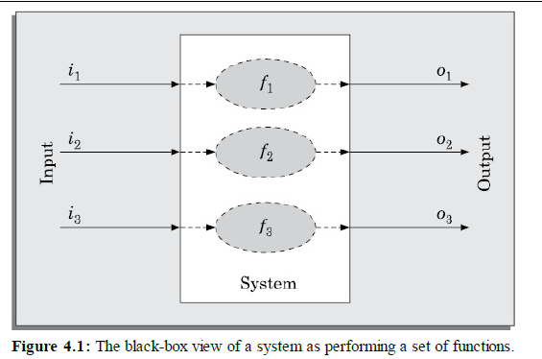
Functional requirements
"hapter *. ”.zquirer”. *nts cneir. erin°
"

Slide 10

Non-functional requirements
These define system properties and constraints e.g. reliability, response time, and storage requirements. Constraints are I/O device capability, system representations, etc.
Process requirements may also be specified mandating a particular IDE, programming language or development method.
Non-functional requirements may be more critical than functional requirements. If these are not met, the system may be useless.
"hapter *. ”.zquirer”. *nts cneir. erin°

Slide 11

Metrics for specifying non-functional requirements
Speed
Processed transactions/second User/event response time Screen refresh time
Mbytes
Number of ROM chips
Training time
Number of help frames
Mean time to failure Probability of unavailability Rate of failure occurrence Availability
Time to restart after failure Percentage of events causing failure
Probability of data corruption on failure
Percentage of target dependent statements
Number of target systems
Size
Ease of use
Reliability
Robustness
Portability

Slide 12

The system's operational domain imposes requirements on the system.
Domain requirements
For example, a train control system has to take into account the braking characteristics in different weather conditions.
Domain requirements can be new functional requirements, constraints on existing requirements, or define specific computations.
If domain requirements are not satisfied, the system may be unworkable.
"hapter *. ”.zquirer”. *nts cneir. erin°

Slide 13
The main purpose of the requirements analysis activity is to analyse the gathered requirements to remove all ambiguities, incompleteness, and inconsistencies from the gathered customer requirements and to obtain a clear understanding of the software to be developed.
Requirements Analysis
During requirements analysis,the analyst needs to identify and resolve three main types of problems in the requirements:
• Anomaly
• Inconsistency
• Incompleteness
"hapter *. ”.zquirer”. *nts cneir. erin°

Slide 14

Agile methods and requirements
4 Many agile methods argue that producing a requirements document is a waste of time as requirements change so quickly
4 The document is therefore always out of date
4 Methods such as XP use incremental requirements engineering and express requirements as ‘user stories’.
"hapter *. ”.zquirer”. *nts cneir. erin°
7 5

Slide 15

The software requirements document
The goal of the requirements analysis and specification phase is to clearly understand the customer requirements and to systematically organise the requirements into a document called the Software Requirements Specification (SRS) document.
"hapter *. ”.zquirer”. *nts cneir. erin°

Slide 16

Characteristics of a Good SRS Document
Concise: The SRS document should be concise and at the same time
unambiguous, consistent, and complete.
Implementation-independent: The SRS should be free of design
and implementation decisions unless those decisions reflect actual
requirements. It should only specify what the system should do and
refrain from stating how to do these. This means that the SRS
document should specify the externally visible behavior of the system
and not discuss the implementation issues.
Traceable: It should be possible to trace a specific requirement to the
design elements that implement it and vice versa. Traceability is also
important to verify the results of a phase with respect to the previous phase
and to analyse the impact of changing a requirement on the design elements
and the code.

Slide 17
Characteristics of a Good SRS Document
Modifiable: Customers frequently change the requirements during the
software development development due to a variety of reasons. To cope up
with the requirements changes, the SRS document should be easily
modifiable. For this, an SRS document should be well-structured. A wellstructured
document is easy to understand and modify.
Identification of response to undesired events: The SRS document
should discuss the system responses to various undesired events and exceptional conditions that may arise.
Verifiable: All requirements of the system as documented in the SRS
document should be verifiable. This means that it should be possible to
design test cases based on the description of the functionality as to whether
or not requirements have been met in an implementation.
.

Slide 18
The software requirements document
An SRS document should clearly document the following aspects of a software:
• Functional requirements
• Non-functional requirements
— Design and implementation constraints
— External interfaces required
— Other non-functional requirements
• Goals of implementation.
"hapter *. ”.zquirer”. *nts cneir. erin°
7 5

Slide 19
The software requirements document
The functional requirements of the system, should clearly describe each functionality that the system would support along with the corresponding input and output data set.
Non-functional requirements usually address aspects concerning external interfaces, user interfaces, maintainability, portability, usability, maximum number of concurrent users, timing, and throughput (transactions per second, etc.).
The goals of implementation section might document issues such as easier
revisions to the system functionalities that may be required in the future,
easier support for new devices to be supported in the future, reusability
issues, etc. These are the items which the developers might keep in their
mind during development so that the developed system may meet some
aspects that are not required immediately.
.
"hapter *. ”.zquirer”. *nts cneir. erin°
7 5

Slide 20
Functional requirements
This section can classify the functionalities either based on the specific
functionalities invoked by different users.
1. User class 1
(a) Functional requirement 1.1
(b) Functional requirement 1.2
2. User class 2
(a) Functional requirement 2.1
(b) Functional requirement 2.2
"hapter *. ”.zquirer”. *nts cneir. erin°
7 5

Slide 21
Non-functional requirements
Performance requirements: Aspects such as number of transaction to be
completed per second should be specified here. Some performance
requirements may be specific to individual functional requirements or
features. These should also be specified here.
Safety requirements: Those requirements that are concerned with possible
loss or damage that could result from the use of the software are specified
here. For example, recovery after power failure, handling software and
hardware failures, etc. may be documented here.
Security requirements: This section should specify any requirements
regarding security or privacy requirements on data used or created by the
software. Any user identity authentication requirements should be described
here. It should also refer to any external policies or regulations concerning
the security issues. Define any security or privacy certifications that must be
satisfied.
.
"hapter *. ”.zquirer”. *nts cneir. erin°
7 5

Slide 22
External interface requirements
User interfaces: This section should describe a high-level description of
various interfaces and various principles to be followed. The user
interface description may include sample screen images, any GUI
standards or style guides that are to be followed, screen layout
constraints, standard push buttons (e.g., help) that will appear on every
screen, keyboard shortcuts, error message display standards, etc. The
details of the user interface design should be documented in a separate
user interface specification document.
Hardware interfaces: This section should describe the interface between
the software and the hardware components of the system. This section may
include the description of the supported device types, the nature of the data
and control interactions between the software and the hardware, and the
communication protocols to be used.
"hapter *. ”.zquirer”. *nts cneir. erin°
7 5

Slide 23
External interface requirements
Software interfaces: This section should describe the connections between
this software and other specific software components, including databases,.
operating systems, tools, libraries, and integrated commercial components,
etc. Identify the data items that would be input to the software and the data
that would be output should be identified and the purpose of each should be
described.
Communications interfaces: This section should describe the requirements
associated with any type of communications required by the software, such
as e-mail, web access, network server communications protocols, etc.
"hapter *. ”.zquirer”. *nts cneir. erin°
7 5

Slide 24
Overall description of organisation of SRS document
Introduction
Purpose: This section should describe where the software would be
deployed and and how the software would be used.
Project scope: This section should briefly describe the overall context within
which the software is being developed.
Environmental characteristics: This section should briefly outline the
environment (hardware and other software) with which the software will
interact.
"hapter *. ”.zquirer”. *nts cneir. erin°
7 5

Slide 25
Overall description of organisation of SRS document
Product perspective: This section needs to briefly state as to whether the
software is intended to be a replacement for a certain existing systems, or it
is a new software. A simple schematic diagram can be given to
show the major components of the overall system, subsystem
interconnections, and external interfaces can be helpful.
Product features: This section should summarize the major ways in which
the software would be used
User classes: Various user classes that are expected to use this software are
identified and described here. The different classes of users are identified by
the types of functionalities that they are expected to invoke, or their levels of
expertise in using computers.
"hapter *. ”.zquirer”. *nts cneir. erin°
7 5

Slide 26
Overall description of organisation of SRS document
Operating environment: This section should discuss in some detail the
hardware platform on which the software would run, the operating system,
and other application software with which the developed software would
interact.
Design and implementation constraints: In this section, the different. constraints on the design and implementation are discussed.
User documentation: This section should list out the types of user
documentation, such as user manuals, on-line help, and trouble-shooting
manuals that will be delivered to the customer along with the software.
"hapter *. ”.zquirer”. *nts cneir. erin°
7 5

Slide 27
USE CASE DIAGRAM
Representation of Use Cases
A use case model can be documented by drawing a use case diagram and writing an accompanying text elaborating the drawing.
In the use case diagram, each use case is represented by an ellipse with the name of the use case written inside the ellipse.
All the ellipses (i.e. use cases) of a system are enclosed within a rectangle which represents the system boundary. The name of the system being modeled (e.g., library information system ) appears inside the rectangle.
The different users of the system are represented by using stick person icons. Each stick person icon is referred to as an actor. An actor is a role played by a user with respect to the system use. It is possible that the same user may play the role of multiple actors.
An actor can participate in one or more use cases.
The line connecting an actor and the use case is called the communication relationship. It indicates that an actor makes use of the functionality provided by the use case.

Slide 28
USE CASE DIAGRAM
How to Identify the Use Cases of a System?
Identification of the use cases involves brain storming and reviewing the
SRS document. Typically, the high-level requirements specified in the
SRS document correspond to the use cases. In the absence of a wellformulated
SRS document, a popular method of identifying the use
cases is actor-based.
This involves first identifying the different types of actors and their usage of the system. Subsequently, for each actor the different functions that they might initiate or participate are identified.
For example, for a Library Automation System, the categories of users
can be members, librarian, and the accountant. Each user typically focuses on a set of functionalities. Foe example, the member typically concerns himself with book issue, return, and renewal aspects. The librarian concerns himself with creation and deletion of the member and book records. The accountant concerns itself with the amount collected from membership fees and the expenses aspects.

Slide 29
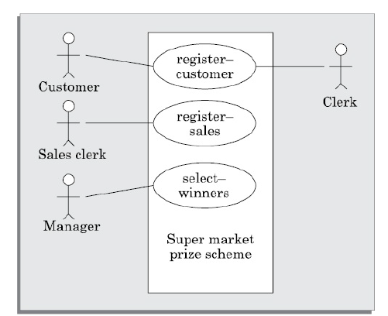
USE CASE DIAGRAM

Slide 30
USE CASE DIAGRAM
Text description
U1: register-customer: Using this use case, the customer can register
himself by providing the necessary details.
Scenario 1: Mainline sequence
1. Customer: select register customer option
2 . System: display prompt to enter name, address, and telephone number.
3. Customer: enter the necessary values
4: System: display the generated id and the message that
the customer has successfully been registered.
Scenario 2: At step 4 of mainline sequence
4 : System: displays the message that the customer has
already registered.
Scenario 3: At step 4 of mainline sequence
4 : System: displays message that some input information
have not been entered. The system displays a prompt to
enter the missing values.

Slide 31
USE CASE DIAGRAM
Text description
U2: register-sales: Using this use case, the clerk can register the details of
the purchase made by a customer.
Scenario 1: Mainline sequence
Clerk: selects the register sales option.
2. System: displays prompt to enter the purchase details
and the id of the customer.
3. Clerk: enters the required details.
4 : System: displays a message of having successfully
registered the sale.
U3: select-winners. Using this use case, the manager can generate the
winner list.
Scenario 2: Mainline sequence
1. Manager: selects the select-winner option.
2 . System: displays

Slide 32
Tutorial 1
Develop a Use Case Diagram for a real-life project under consideration.
Team Size 2
Submit a Hard Copy
Date and Time of Submission: 09/10/2024 , 9am

Slide 33

Requirements engineering processes
4 The processes used for RE vary widely depending on the application domain, the people involved and the organisation developing the requirements.
4 However, there are a number of generic activities
common to all processes
Requirements elicitation;
Requirements analysis;
Requirements validation;
Requirements management.
4 In practice, RE is an iterative activity in which these processes are interleaved.
"hapter *. ”.zquirer”. *nts cneir. erin°
42

Slide 34
Requirements engineering processes
Requirements Elicitation
What is requirements elicitation?
Requirements elicitation involves working with customers to determine the application domain, the services that the system should provide, and the operational constraints of the system.
Elicitation may involve end-users, managers, engineers involved in maintenance, domain experts, trade unions, and so on. These people are collectively called stakeholders.
What is a requirements validation?
Requirement validation is the process of checking and confirming that the requirements defined for development accurately capture the needs and expectations of the stakeholders. So now you know it's a systematic approach ensuring the requirements are clear, unambiguous, verifiable, and achievable.
"hapter *. ”.zquirer”. *nts cneir. erin°
42

Slide 35
Requirements engineering processes
Requirements Modeling
How are software requirements modeled?
There are a number of ways to model software requirements; these include
natural languages, informal and semiformal techniques, user stories, use
case diagrams, structured diagrams, object-oriented techniques, formal
methods, and more.
What are user stories?
User stories are short conversational texts that are used for initial requirements discovery and project planning. User stories are widely used in conjunction with agile methodologies.
User stories are written by the customers in their own “voice,” in terms
of what the system needs to do for them. User stories usually consist of
two to four sentences written by the customer in his own terminology,
usually on a three-by-five inch card. The appropriate amount of user
stories for one system increment or evolution is about 80, but the appropriate number will vary widely depending upon the application size and scope.
"hapter *. ”.zquirer”. *nts cneir. erin°
42

Slide 36

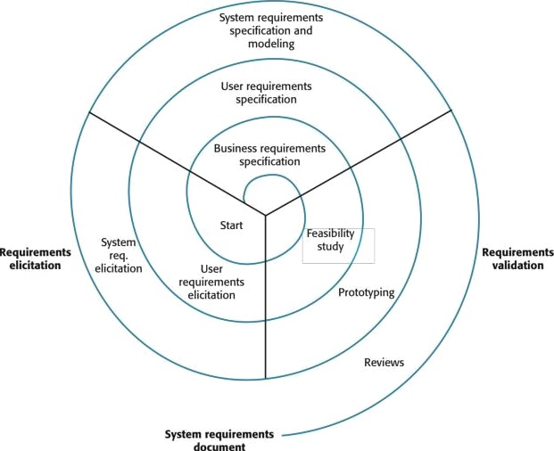
A spiral view of the requirements engineering process
Chapter 4 Requirements engineering
43

